Slide 1
PHRF-LO AGM
January 2021
7.2 Handicapping Rule Change Proposals
  Limit the minimum symmetrical spinnaker Mid-Girth (MG)
  Spinnaker girth measurement change
  FS handicap shall not be slower than NFS on a certificate
  CL fixed sprit credit change
  Free Flying Genoa (FFG) for Point-to-Point (P2P) Racing
  Assessing Keel types for Speed Potential
  Handicappers Manual Part I - Revision

Slide 2
a) Minimum Symmetrical Spinnaker MG
Rule: Symmetrical spinnakers shall have an MG greater than 75% of the foot.
Explanation: This will be consistent with the proposed FFG rule (see below), where any spinnaker like sail with an MG<75% of the foot is defined as a Free Flying Genoa (FFG) and not allowed in WW/LW races.
Impact: This is essentially closing a potential loophole in the rule.

Slide 3
b) Spinnaker Girth Measurement
Rule: Replace the symmetrical spinnaker max-girth measurement with the mid-girth measurement for sail area calculations. The measurement shall follow the definition in the Equipment Rules of Sailing (ERS).
Explanation: The measurement is easier to do on a consistent and repeatable basis. Most handicapping systems and one design rules follow this method. The existing area calculation formula remains valid and accurate.
Impact: The difference between the Max-girth and Mid-girth is likely very small, and the Mid-girth measurement is usually smaller or equal. It will be in the best interest of the owners to update their measurements for a potential small handicap improvement, but will not be mandatory on existing sails.

Slide 4
c) FS shall not be slower than NFS
Rule: The FS-ASP handicap shall not be handicapped slower (numerically greater) than the NFS-ASP on a PHRF-LO certificate.
Explanation: Some boats have declared a CL sprit modification with a very small spinnaker that resulted in an unfair +6 s/m credit and the full spinnaker credit with no intention of using this configuration.
Impact: This is essentially closing a potential unfair loophole in the rule – Housekeeping item only, immediate implementation.

Slide 5
d) CL Fixed Sprit Credit
Rule: Change the centerline fixed sprit credit from +6 s/m to +3 s/m for all CTP class boats and conversions. Maintain all class ASP’s unchanged and adjust the SP’s as necessary. CTP converted/modified boats shall keep their SP’s unchanged.
Explanation: The P2P handicap rule change proposal includes a -6 s/m penalty for CTP conversions, and -3 s/m for classes designed with fixed sprit. This is inconsistent in penalizing the conversions (shorter sprits) more than the longer sprits.
Impact: No change in class configured boats in ASP for WW/LW races. Reduces the CTP penalty for Point to Point (P2P) handicaps from -6 s/m to -3 s/m, but CTP conversions will enjoy 3 s/m less credit for WW/LW races, and reduced penalties for P2P.

Slide 6
e) Free Flying Genoa (FFG)
Rule: Adopt a new Free Flying Genoa (FFG – as defined in the ERS) rule for point-to-point race courses only; all spinnaker like asymmetrical sails with MG measurement less than 75% but greater than 55% of the foot shall be measured, and the largest one in the inventory shall carry an area penalty based on the area difference between the largest upwind headsail and the largest FFG in the inventory.
  The FFG area shall be measured and its area calculated as an asymmetrical spinnaker. Penalty is -1 s/m for each 5% sail area above 155% of the foretriangle. Minimum penalty shall be –1 s/m. (Credit for small LP jibs retained in the ASP.)
  FFGs with less than 55% of the foot shall be measured and assessed as Jibs/genoas.
  The FFG can be flown off the CTP with a –3 s/m penalty, when the class/boat has been handicapped with the CTP.
  No additional penalty shall apply for an FFG flown off an articulating pole, sprit or bow fitting.

Slide 7
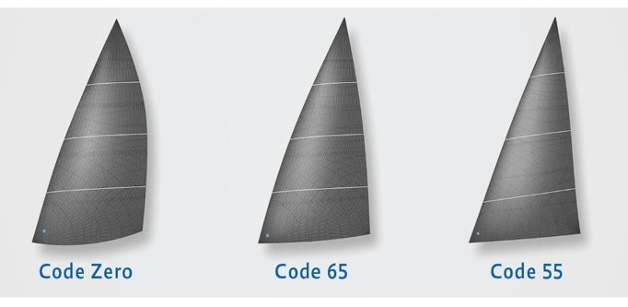
e) Free Flying Genoa (FFG)

Slide 8
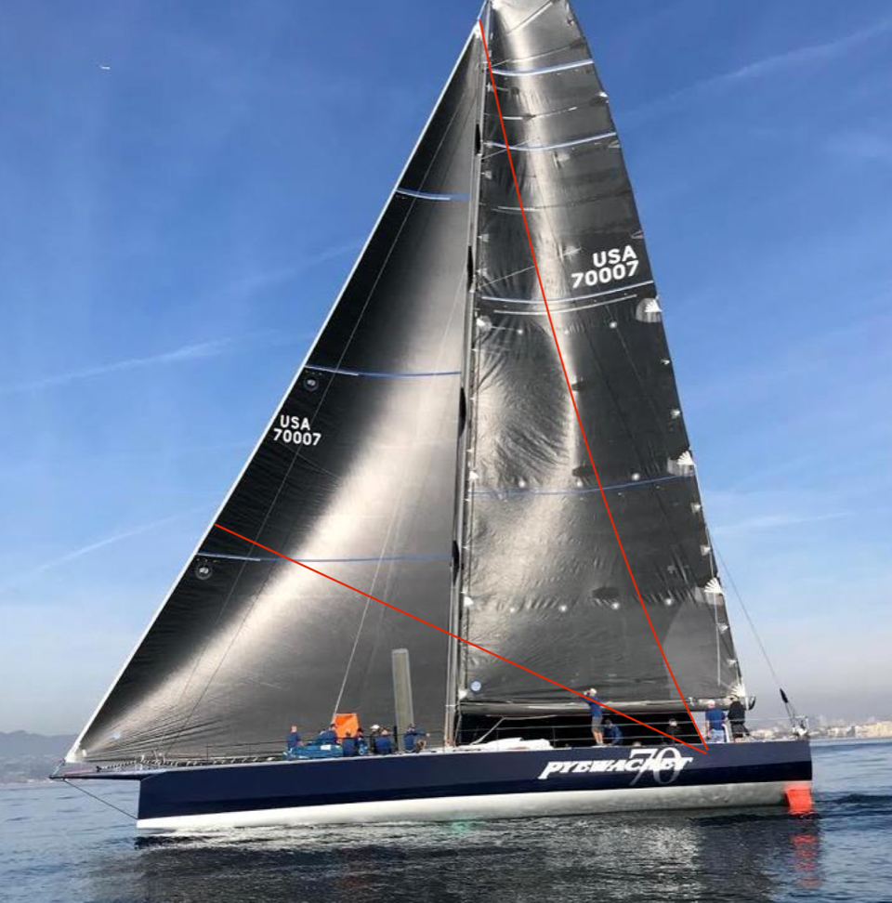
e) Free Flying Genoa (FFG)

Slide 9
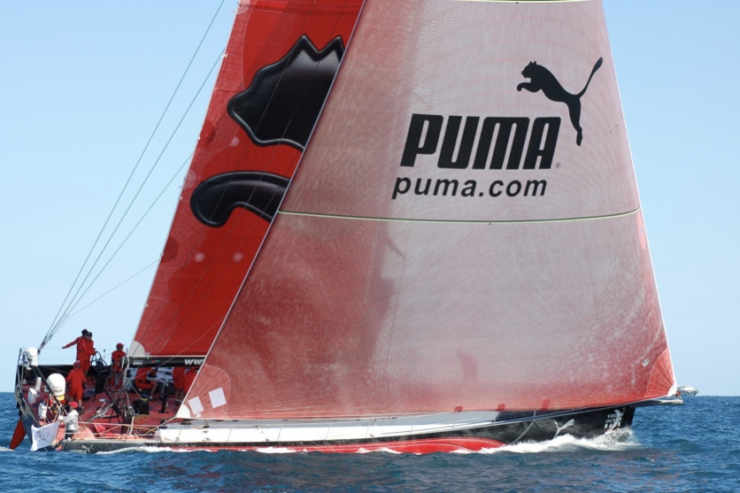
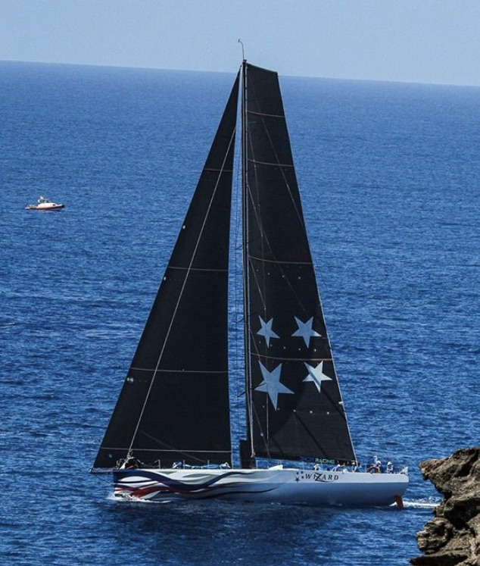
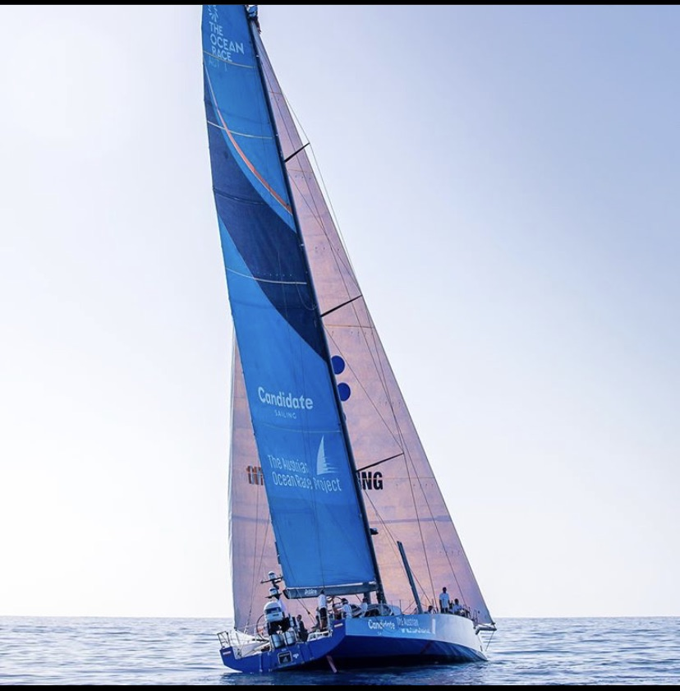
Free Flying Genoa (FFG)

Slide 10
e) Free Flying Genoa (FFG)
Explanation: FFGs have been and are still illegal to be flown in all PHRF-LO races unless this rule change is implemented. Other handicapping systems allow FFGs but handicap them separately.
Impact: Essentially all types of headsails will be allowed in Point-to-Point racing with an appropriate assessment.
Staysails flown inside the foretriangle will not be penalized if the LP is not greater than the largest headsail.
The FFG shall remain disallowed in Windward-Leeward racing under the PHRF-LO Rule.

Slide 11
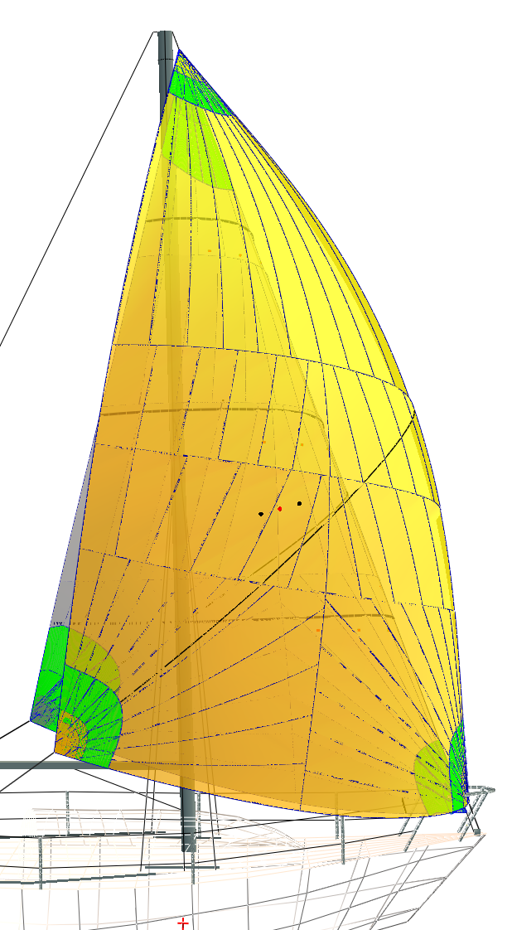
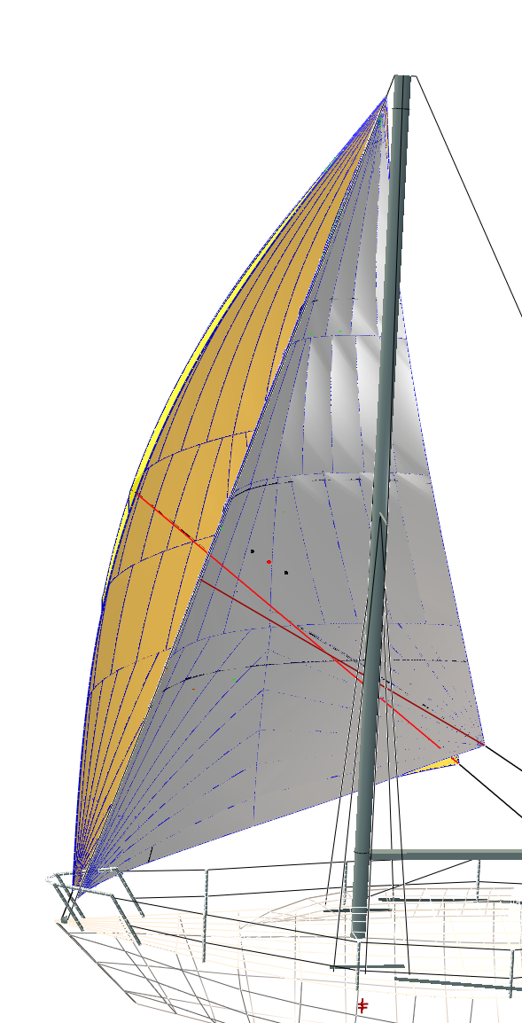
e) Free Flying Genoa (FFG)
Where it works:
Masthead cruising boat
Example: C&C Redwing 30
This is where this sail type is most likely to be used;
Smallest real spinnaker vs. smallest FFG
FFG is only 99% of largest headsail so would not be penalized or perform much better than the largest headsail.
Useful for sail handling

Slide 12
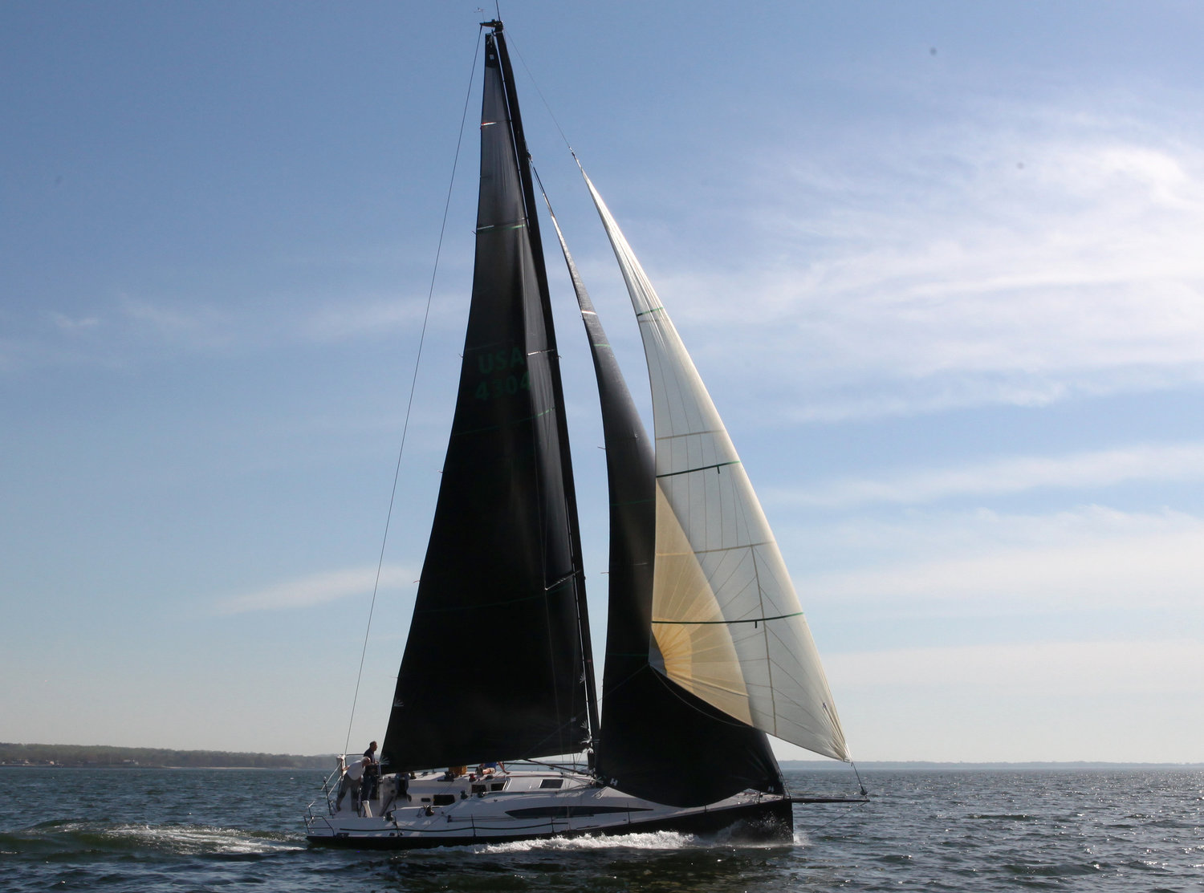
e) Free Flying Genoa (FFG)
Jib Top

Slide 13
f) Keel Assessment
Rule: Adopt a numerical keel assessment system based on:
  Low center of gravity and/or
  Modern high aspect ratio efficient keel foil sections
  Associated with a collection of keel design types outlined in sketches
  The proposed adjustment values should be utilized primarily at the time of initial assessment of:
    (i) new boats to PHRF-LO as compared to similar boats and keels,
    (ii) same boats with different keel options on relative basis, and
    (iii) keel modifications to an existing class of boat.

Slide 14
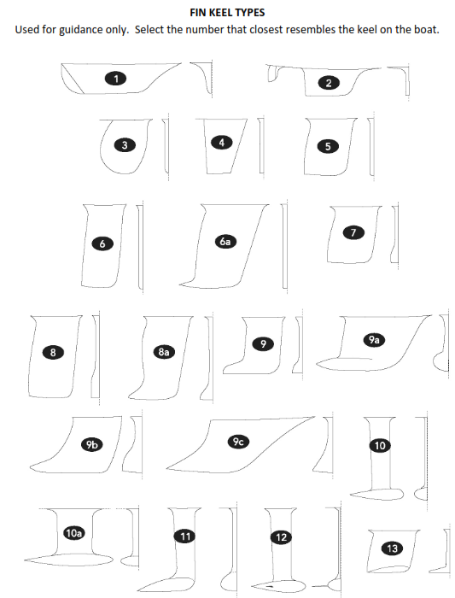
f) Keel Assessment
Fin Keel Types and penalties
ID |  | Description | Low CG | Efficient foil | Penalty
1. |  | Traditional, attached rudder |  |  | 0
2. |  | Long keel with separate rudder |  |  | 0
3. |  | Elliptical fin / ‘Mickey Mouse’ |  | -3 | -3
4. |  | Tapered fin |  |  | 0
5. |  | Straight fin |  |  | 0
6. |  | Straight deep fin |  |  | 0
6. | a) | Straight deep fin with vortex shedding tip |  | -3 | -3
7. |  | Flare, low CG | -3 |  | -3
8. |  | Flare, low CG deep fin | -3 |  | -3
8. | a) | Flare, low CG deep fin with vortex shedding tip | -3 |  | -3
9. |  | 'L' Bulb, low CG | -3 |  | -3
9. | a) | 'L' Bulb, shoal draft, low CG | -3 |  | -3
9. | b) | 'L' Bulb, shoal draft, low CG with vortex shedding tip | -3 |  | -3
9. | c) | 'L' Bulb, shoal draft, low CG, Scheel design | -3 |  | -3
10. |  | 'T' Bulb, deep fin | -3 | -3 | -6
10. | a) | 'T' Bulb, shoal draft | -3 | -3 | -6
11. |  | 'L' Bulb, deep fin | -3 | -3 | -6
12. |  | Deep Bulb with winglets | -3 | -3 | -6
13 |  | Wing keel | -3 | 6 | 3

Slide 15
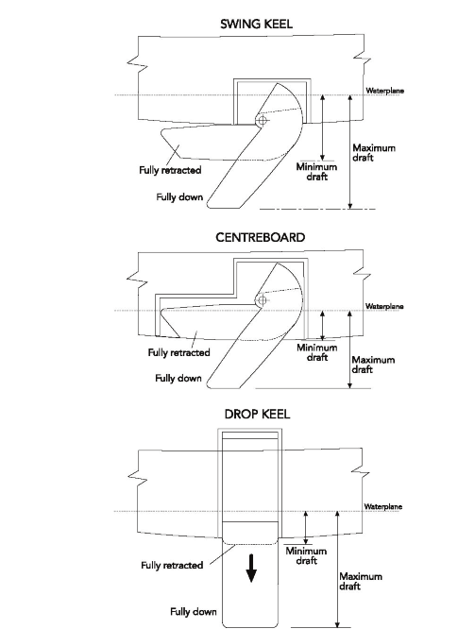
f) Keel Assessment
14
ID |  | Description | Low CG | Efficient foil | Penalty
14. |  | Swing Keel exposed or in shoal draft casing |  | +6 | +6
15. |  | Centerboard |  | +6 | +6
16. |  | Drop Keel (no bulb)/ Daggerboard | +3 |  | +3
15
16

Slide 16
f) Keel Assessment
Explanation: The present PHRF-LO Rule Manual has no consistent and concise guideline for numerically handicapping different type of keels either on absolute or relative basis. The new rule provides a graded approach based on qualitative information available publicly.
Impact: The aim is to provide consistent handicaps.
Help is provided to handicappers in addressing the speed potential of various keel designs, with attention to the recent technically advanced appendages. Also there is a potential for re-visiting classes or boats in case of appeals or flags raised in performance assessment reviews.

Slide 17
g) Handicappers Manual Part I - Revision
Proposal: Modify the Handicapping Rules applicable to changes to Part II of the Manual to include specifically to "Section 6" only.
Explanation: Section 2.3.: Handicapping Changes that affect PART II Section 6 Adjustments to SP Handicaps of the Handicappers Manual, will be ready for presentation at the Annual Meeting, the year previous to when the changes take effect. With a "draft" of PART II available for viewing by Sept 1st of the previous year.
NOTE: Exceptions will be made for minor housekeeping corrections as noted.

